Slide 1


Optimization of Courier-Order Matching and Delivery Performance for In-Time Delivery Systems
Yi Fan¹, Yufeng Cao², Xi Xiong¹, Keji Wei^{1*}
¹Tongji University ²Shanghai Jiao Tong University
July 2025 Singapore
Notes:
Good morning everyone!
My name is Fan Yi. I'm an incoming master student at Shanghai Jiao Tong University. Today, I’m excited to share our work when I was an undergraduate student in Tongji University. This work is advised by ...
30'

Slide 2


In-Time Delivery
A central platform with multiple individuals deals with the demand from customers within a time window.
Last-mile delivery market
On-demand food delivery
Ride-hailing
Emergency medical logistics
Demand Flow
Customers
Notes:
In-Time Delivery is more than just getting something from point A to point B. At its core, In-Time Delivery imagines a sophisticated system where the input is a continuous demand flow from our customers. The output, naturally, is the precise and timely fulfillment of these orders. Inside this system, we envision a central platform with multiple individuals that deals with this continuous demand from customers within a predefined time window.
40'

Slide 3

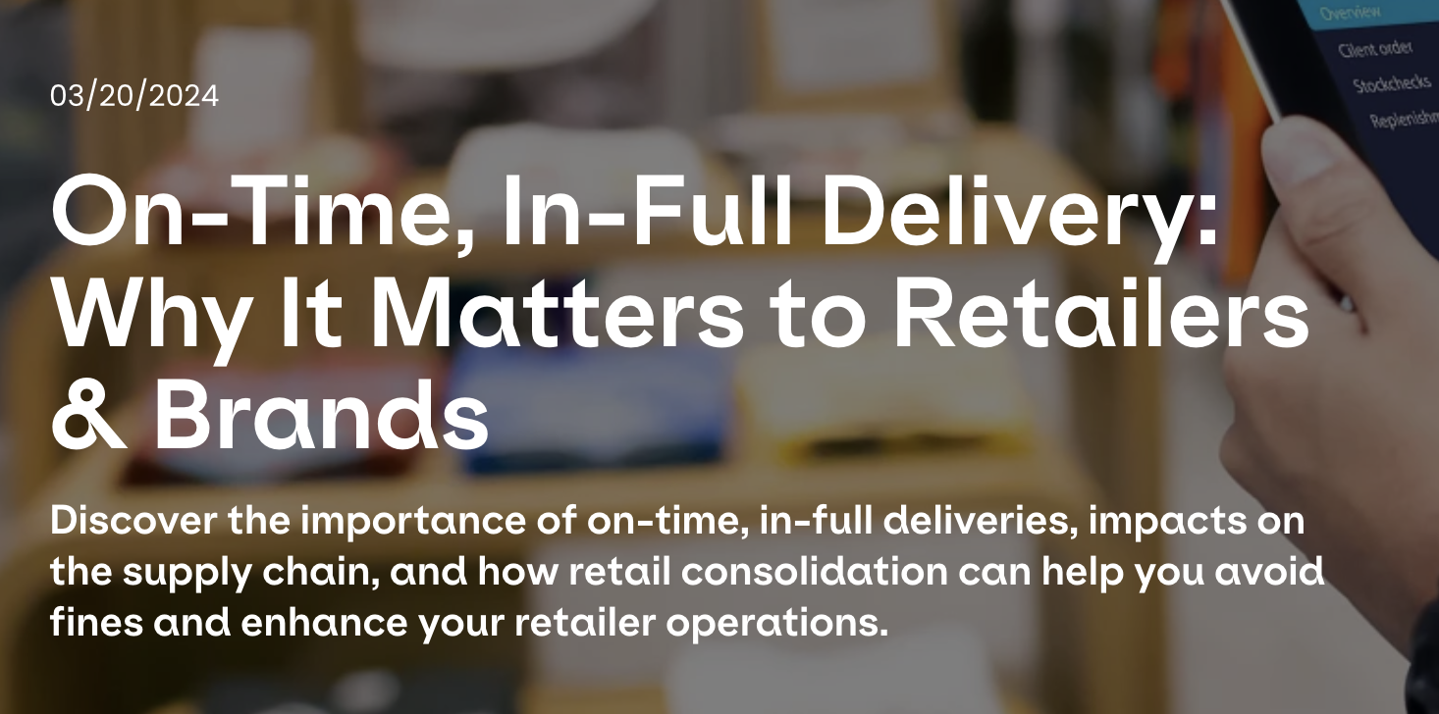
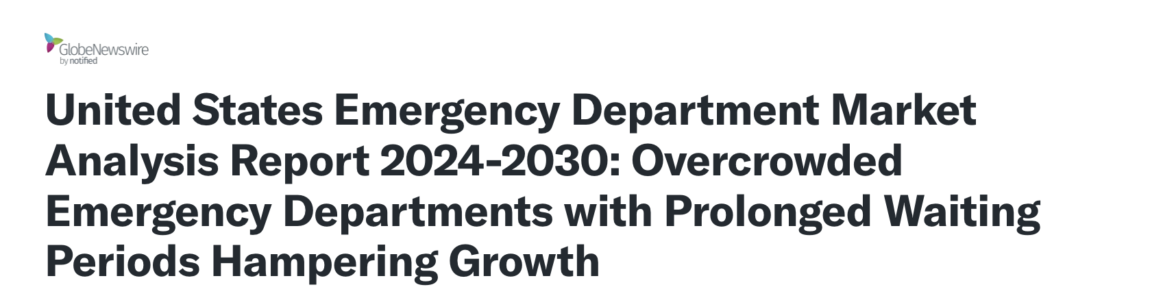
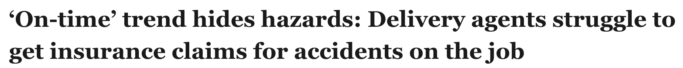
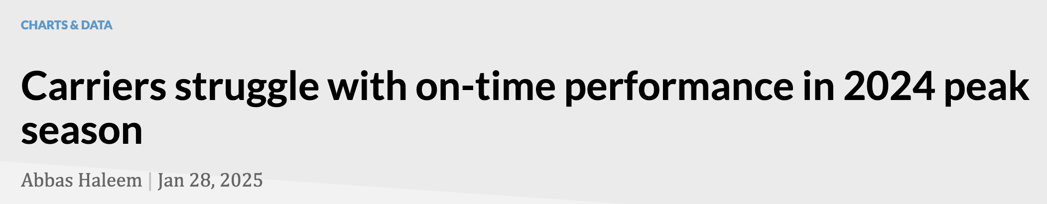
Background
Challenges:
Efficiently managing surging demand;
Optimize system operations leveraging scenario-specific characteristics;
Addressing deteriorating labor welfare and inherent safety risks.
Notes:
This evolution of in-time delivery prompts a crucial question: Why does it matter to retailers, to customers, and to brands? For the customers, the answer is clear: it brings convenience and accessibility for services. extend the service region for the suppliers. Moreover, it provides the couriers with more job opportunities.
However, beneath this success lie significant challenges. We observe fierce competition among large corporations for market dominance. The inefficiency operations cause prolonged waiting times. The couriers struggle with the time window with insufficient insurance.
So here is the challenges. Prioritily, the system should...
1min30s

Slide 4
Related Work
Order Assignment Optimization
Assignment strategies like pooling or batching approaches (Simoni, 2023, TRC; Liang, 2024, KDD);
ML-based techniques for recommendation or matching feature detection (Wang, 2023, TITS; Zheng, 2023, TITS; Chen, 2024, TITS).
Courier Behavior Modeling
Courier route decisions and travel time prediction (Gao, 2021, KDD; Reyes, 2018, Optimization Online; Yildiz, 2019, TS);
Optimization of service and dispatching area (Yang, 2024, TRC);
Balance heterogeneous couriers types (Behrendt, 2023, TS; Auad, 2024, TS).
Spatiotemporal Demand Estimation
Model possible occurrence and distribution of orders (Guda, 2019, MS; Liang, 2024, INFORMS Journal on Applied Analytics);
Demand Anticipation for Strategic Dispatching (Voccia, 2019, TS).
Notes:
In previous research, optimization-based methods have focused on improving courier routes and order assignments. For example, some quantified how well orders match with specific couriers, some worked on grouping orders into batches for more efficient assignments while others modeled the possible distribution of new orders using statistical methods.
On the machine learning side, some researchers explored how to optimally schedule both platform riders and crowdsourced riders, some addressed the issue of determining the size of the platform’s service area while others applied reinforcement learning to make delivery recommendations.
However, most of these methods prioritize efficiency over equity. Scalability in a dynamic system is still a problem and previous research haven't deeply analyzed courier's behavior.
Limitations
Focus on specific sub-problem rather than holistic system optimization;
Methodological bias towards efficiency, with insufficient consideration of equity;
Lack of effective solutions for scalability and adaptability in dynamic food delivery system;
Insufficient modeling and learning of courier behavior.

Slide 5
Motivation
Propose a novel and generalizable framework for the large-scale, time-sensitive in-time delivery system that:
Enables efficient and adaptive responses to dynamic and surging demand;
Balances the diverse and potentially conflicting objectives of multiple stakeholders;
Extends optimization horizons to long-term sustainability and performance.
Notes:
1min

Slide 6
Contributions
Modeling:
RL+OR hybrid framework
A bi-level solution paradigm
Algorithmic Structure:
Multi-agent problem: Grouped-Actor Policy Proximal Optimization (GAPPO) algorithm.
Demand estimation: Spatio-Temporal Demand Forecasting Model (STDFM);
Matching: Delay Matching with Estimation (DM&F) algorithm;
Delivery adjustment: Greedy Adjustment Sequence (GAS) algorithm.
Validation & Results:
On-demand food delivery
Meituan’s operational-level dataset;
Quantification integrats both efficiency and equity, including order completion rate, delivery efficiency, and workload distribution.
Notes:
totally 1min

Slide 7
Contributions
Modeling:
RL+OR hybrid framework
A bi-level solution paradigm
Algorithmic Structure:
Multi-agent problem: Grouped-Actor Policy Proximal Optimization (GAPPO) algorithm.
Demand estimation: Spatio-Temporal Demand Forecasting Model (STDFM);
Matching: Delay Matching with Estimation (DM&F) algorithm;
Delivery adjustment: Greedy Adjustment Sequence (GAS) algorithm.
Validation & Results:
On-demand food delivery
Meituan’s operational-level dataset;
Quantification integrats both efficiency and equity, including order completion rate, delivery efficiency, and workload distribution.

Slide 8
Contributions
Modeling:
RL+OR hybrid framework
A bi-level solution paradigm
Algorithmic Structure:
Multi-agent problem: Grouped-Actor Policy Proximal Optimization (GAPPO) algorithm.
Demand estimation: Spatio-Temporal Demand Forecasting Model (STDFM);
Matching: Delay Matching with Estimation (DM&F) algorithm;
Delivery adjustment: Greedy Adjustment Sequence (GAS) algorithm.
Validation & Results:
On-demand food delivery
Meituan’s operational-level dataset;
Quantification integrats both efficiency and equity, including order completion rate, delivery efficiency, and workload distribution.

Slide 9
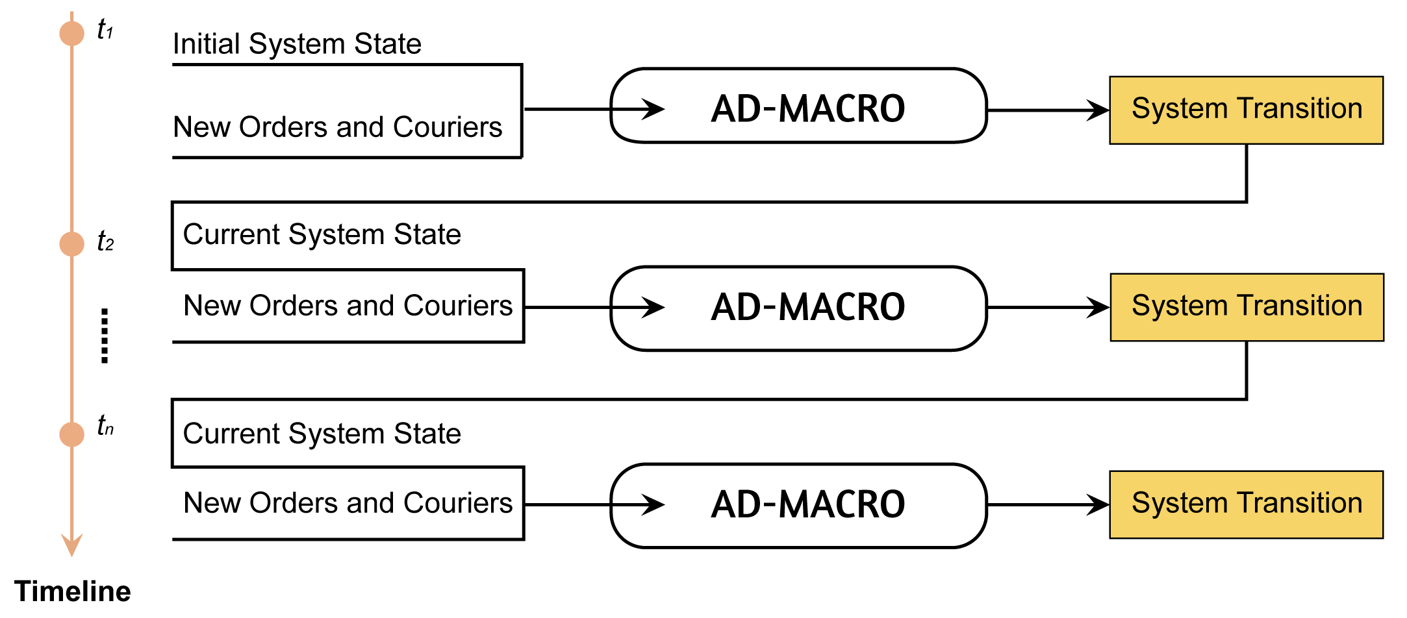
Adaptive Delivery Matching with Agent-based Courier Reinforcement Optimization (AD-MACRO)
The entire system is formulated as a Markov Decision Process (MDP);
This interaction forms a continuous feedback loop.
Notes:
1min

Slide 10
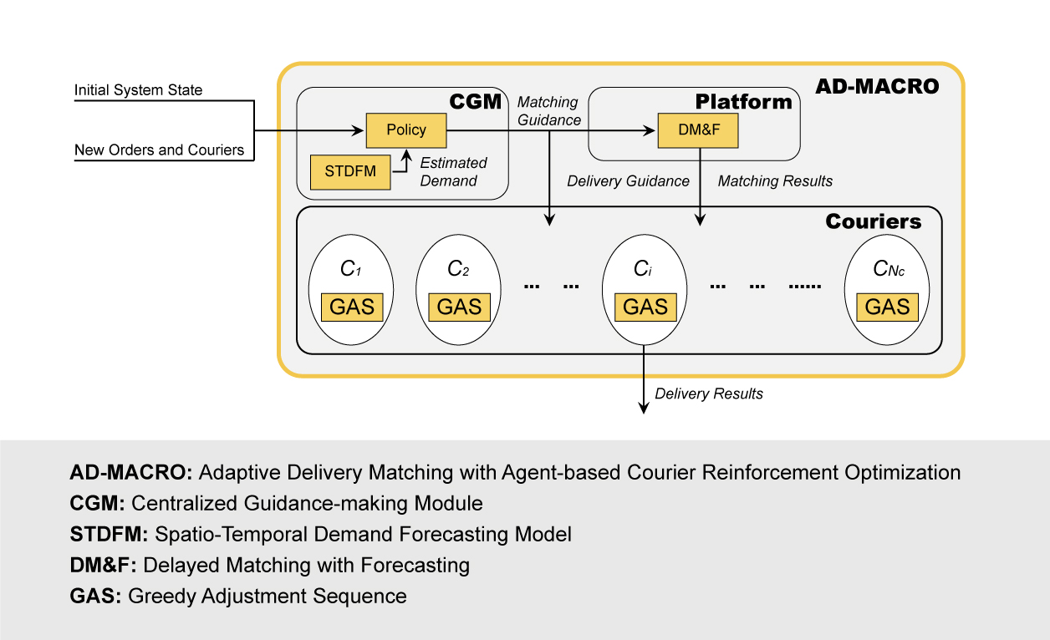
Adaptive Delivery Matching with Agent-based Courier Reinforcement Optimization (AD-MACRO)
Notes:
2min

Slide 11
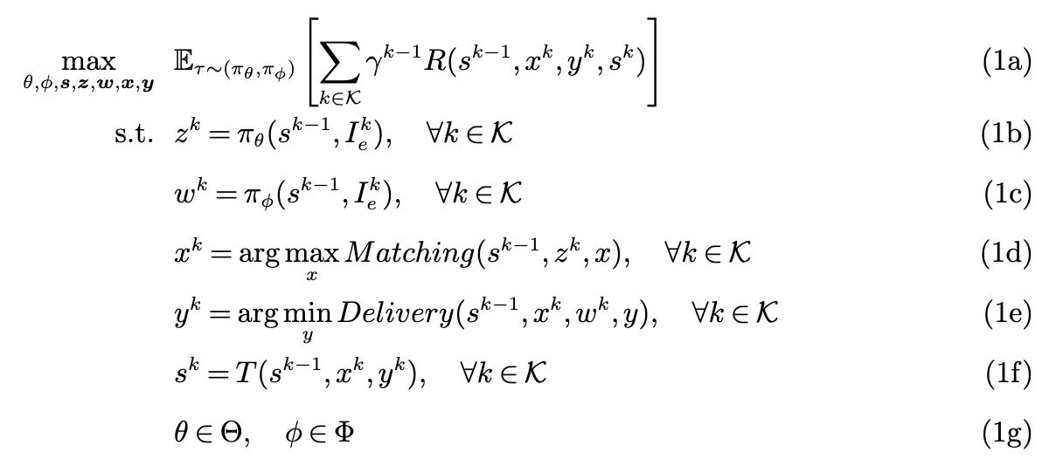
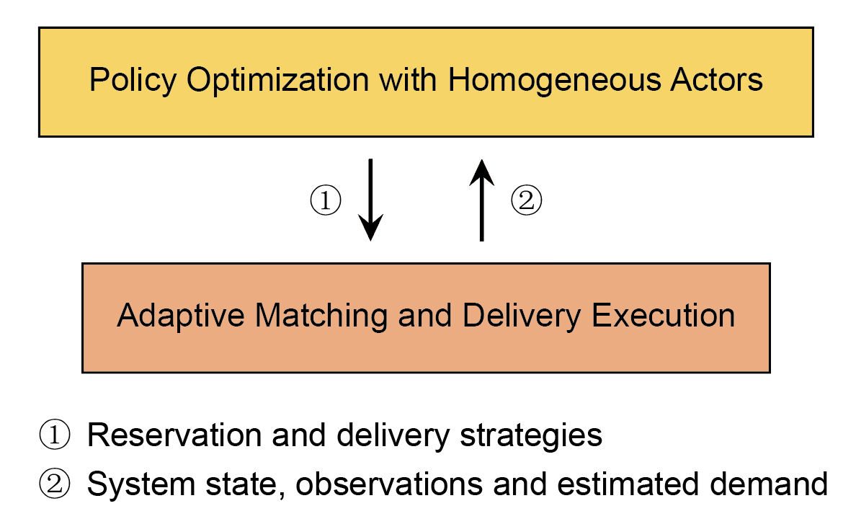
Adaptive Delivery Matching with Agent-based Courier Reinforcement Optimization (AD-MACRO)
Mathematical Form:
Spatio-Temporal Demand Forecasting Model (STDFM):
Spatial Component: Gaussian Mixture Model (GMM);
Temporal Component: Bidirectional Long Short-Term Memory (BiLSTM).
Notes:
1min

Slide 12
Upper Layer: Policy Optimization with Homogeneous Actors
Decentralized Partially Observable Markov Decision Process (Dec-POMDP)
Action Space
Matching guidance: courier reservation decision
Delivery guidance: delivery route & speed
Reward
Matching performance
Delivery efficiency
Speeding penalty
Service quality
Opportunity cost of reservation
Notes:
1min30s

Slide 13
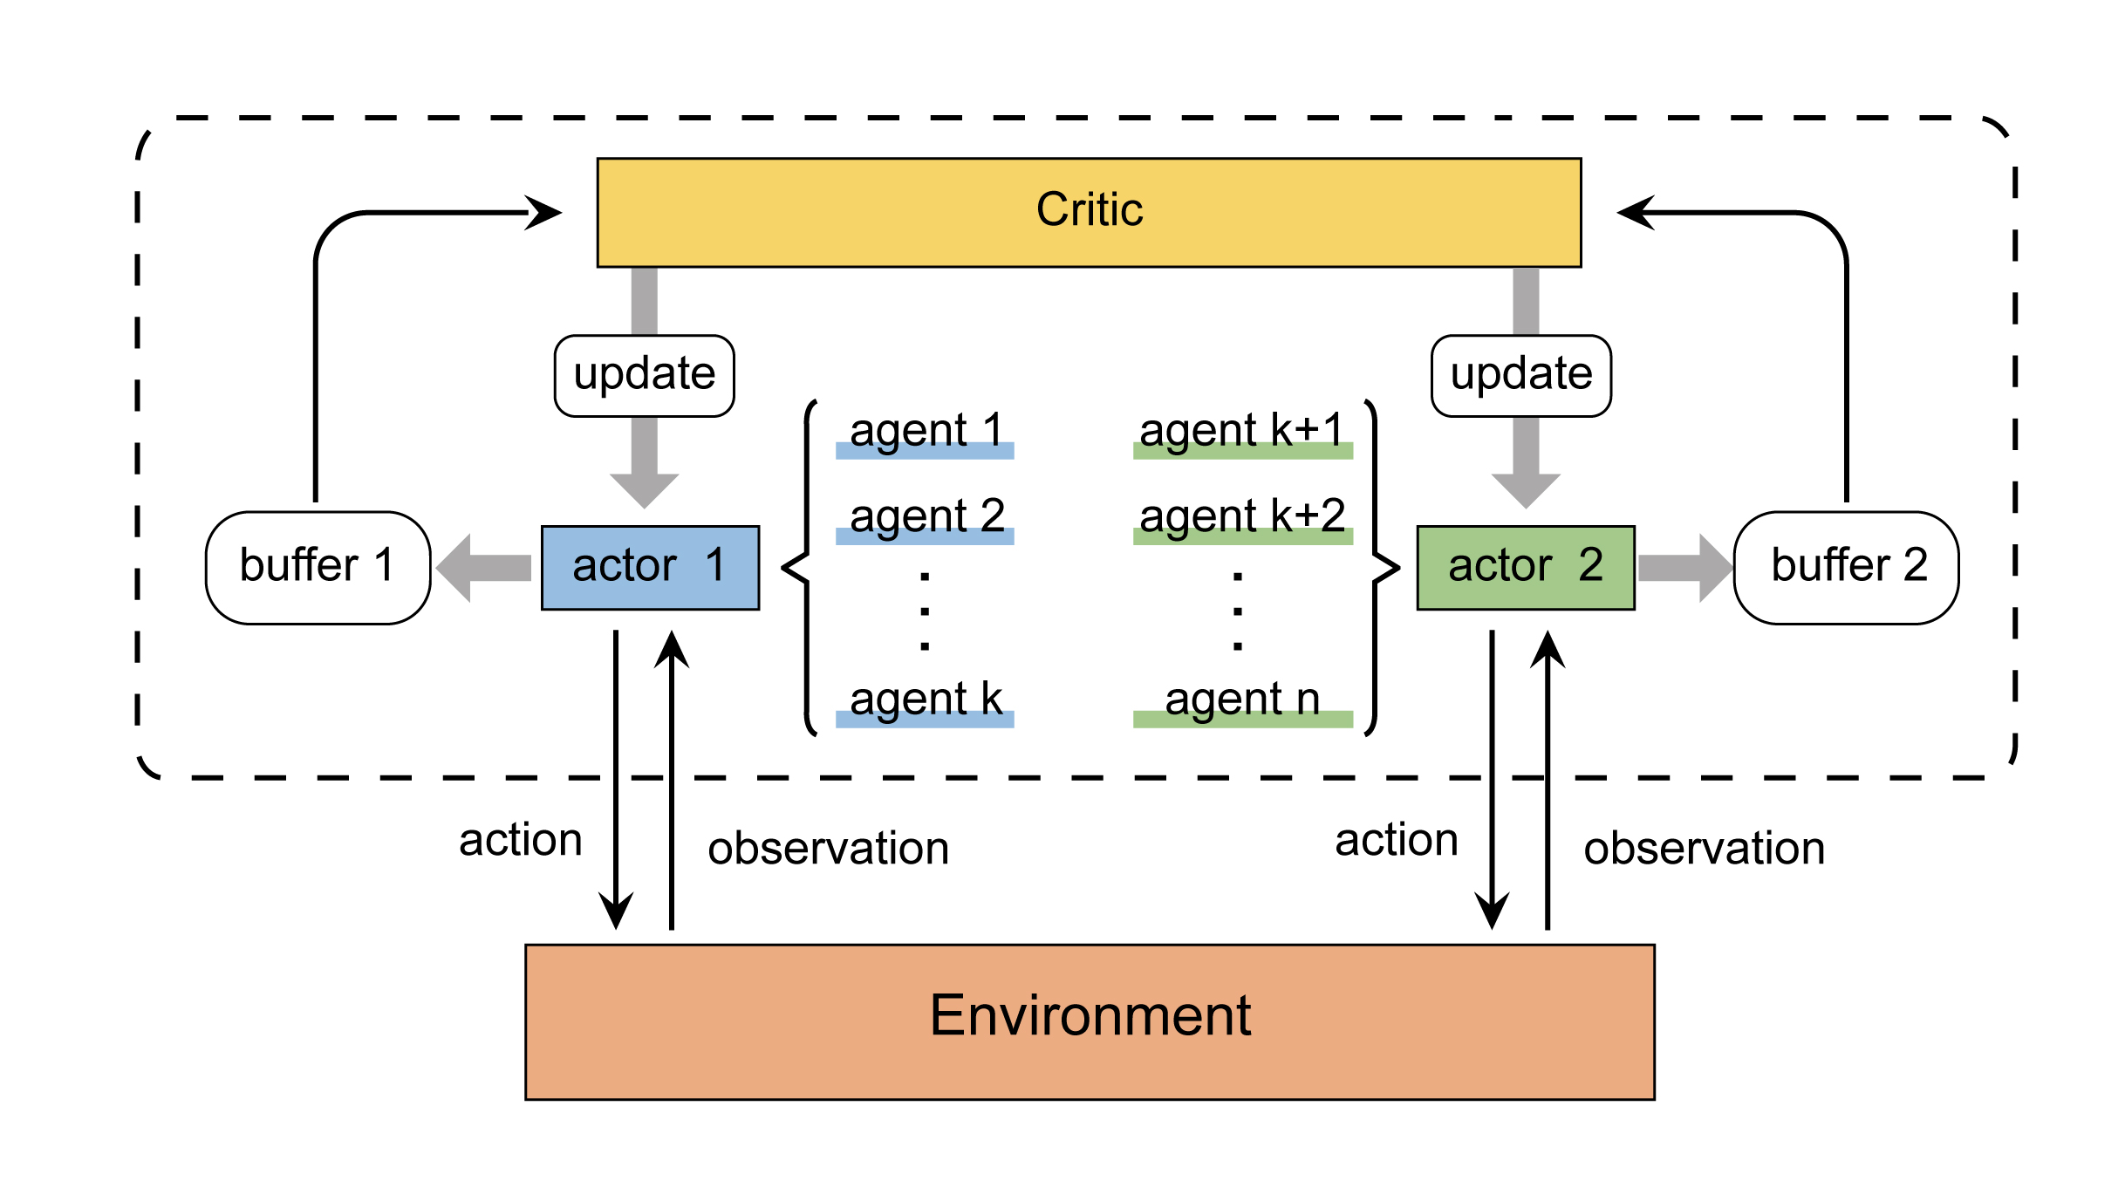
Upper Layer: Policy Optimization with Homogeneous Actors
Grouped-Actor Proximal Policy Optimization (GAPPO)
Agent-grouping mechanism with shared buffer and policy;
Centralized Training with Decentralized Execution (CTDE) paradigm.
Notes:
1min

Slide 14
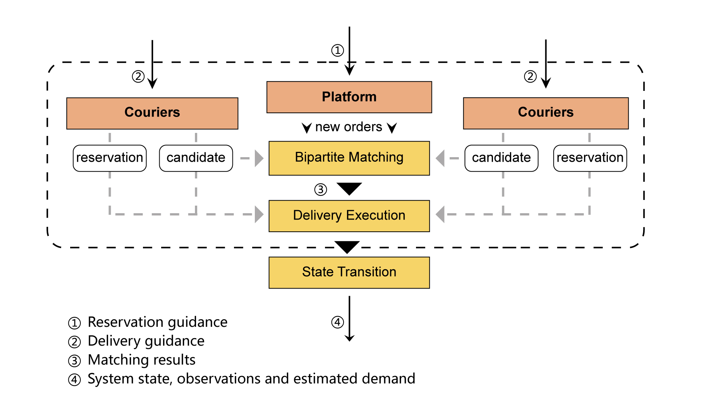
Lower Layer: Adaptive Matching and Delivery Execution
Notes:
1min30s

Slide 15
Lower Layer: Adaptive Matching and Delivery Execution
Delay Matching with Forecasting Algorithm (DM&F)
Cluster the orders geographically
New orders
Order batches
Compute the matching score between each pair
Bipartite matching
Reservation filter (matching guidance)
Couriers
Available couriers
Reserved couriers
Notes:
1

Slide 16
Lower Layer: Adaptive Matching and Delivery Execution
Single-Vehicle Pickup and Delivery Problem with Time Window (SVPDPTW)
Greedy Adjustment Sequence (GAS):
Generate a feasible route by minimizing the travel distance;
Examine the segment and apply local adjustment.
Notes:
1min

Slide 17
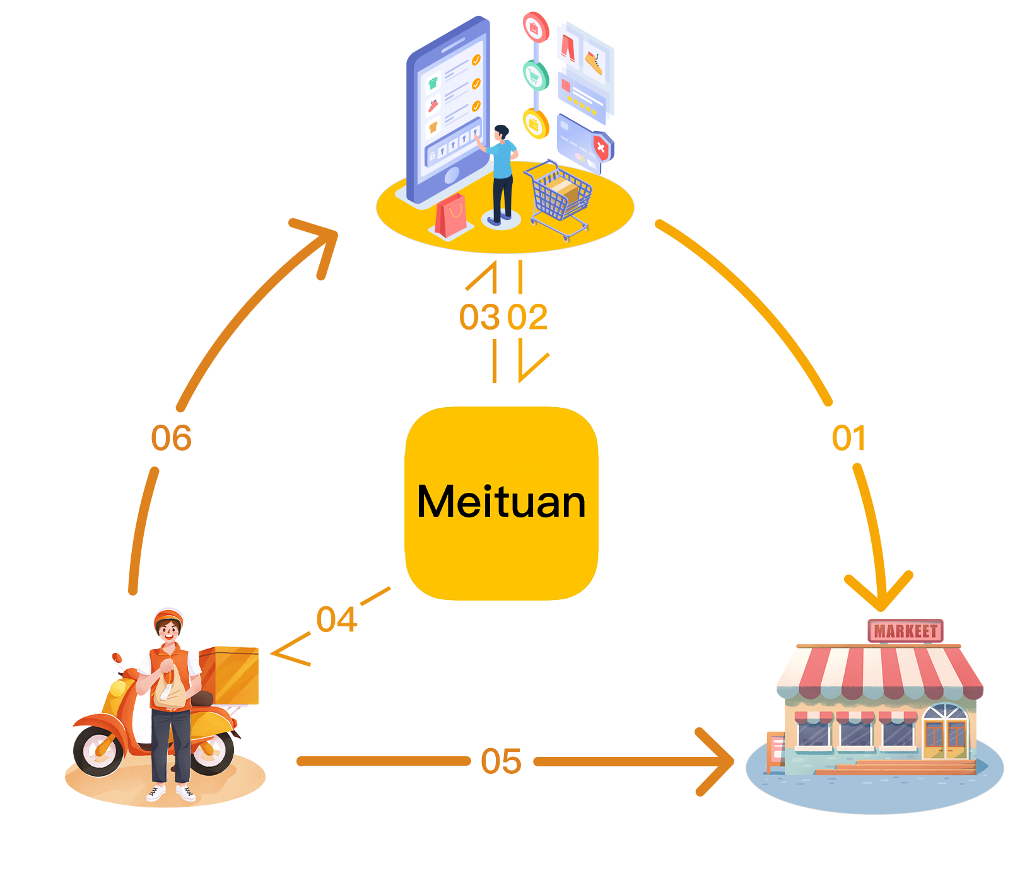
Case Study: Food Delivery
Customers browse restaurants on the app;
Customers dynamically submit orders to the platform;
Platform sends the orders to the restaurant and pertinent information to customers, such as estimated time of arrival (ETA);
Platform assigns the orders to suitable couriers, who retain the option to reject the assignment;
Assigned couriers pick up the orders at the designated restaurant;
Couriers drop off orders at the customers' locations within specified time window.
Notes:
1min

Slide 18
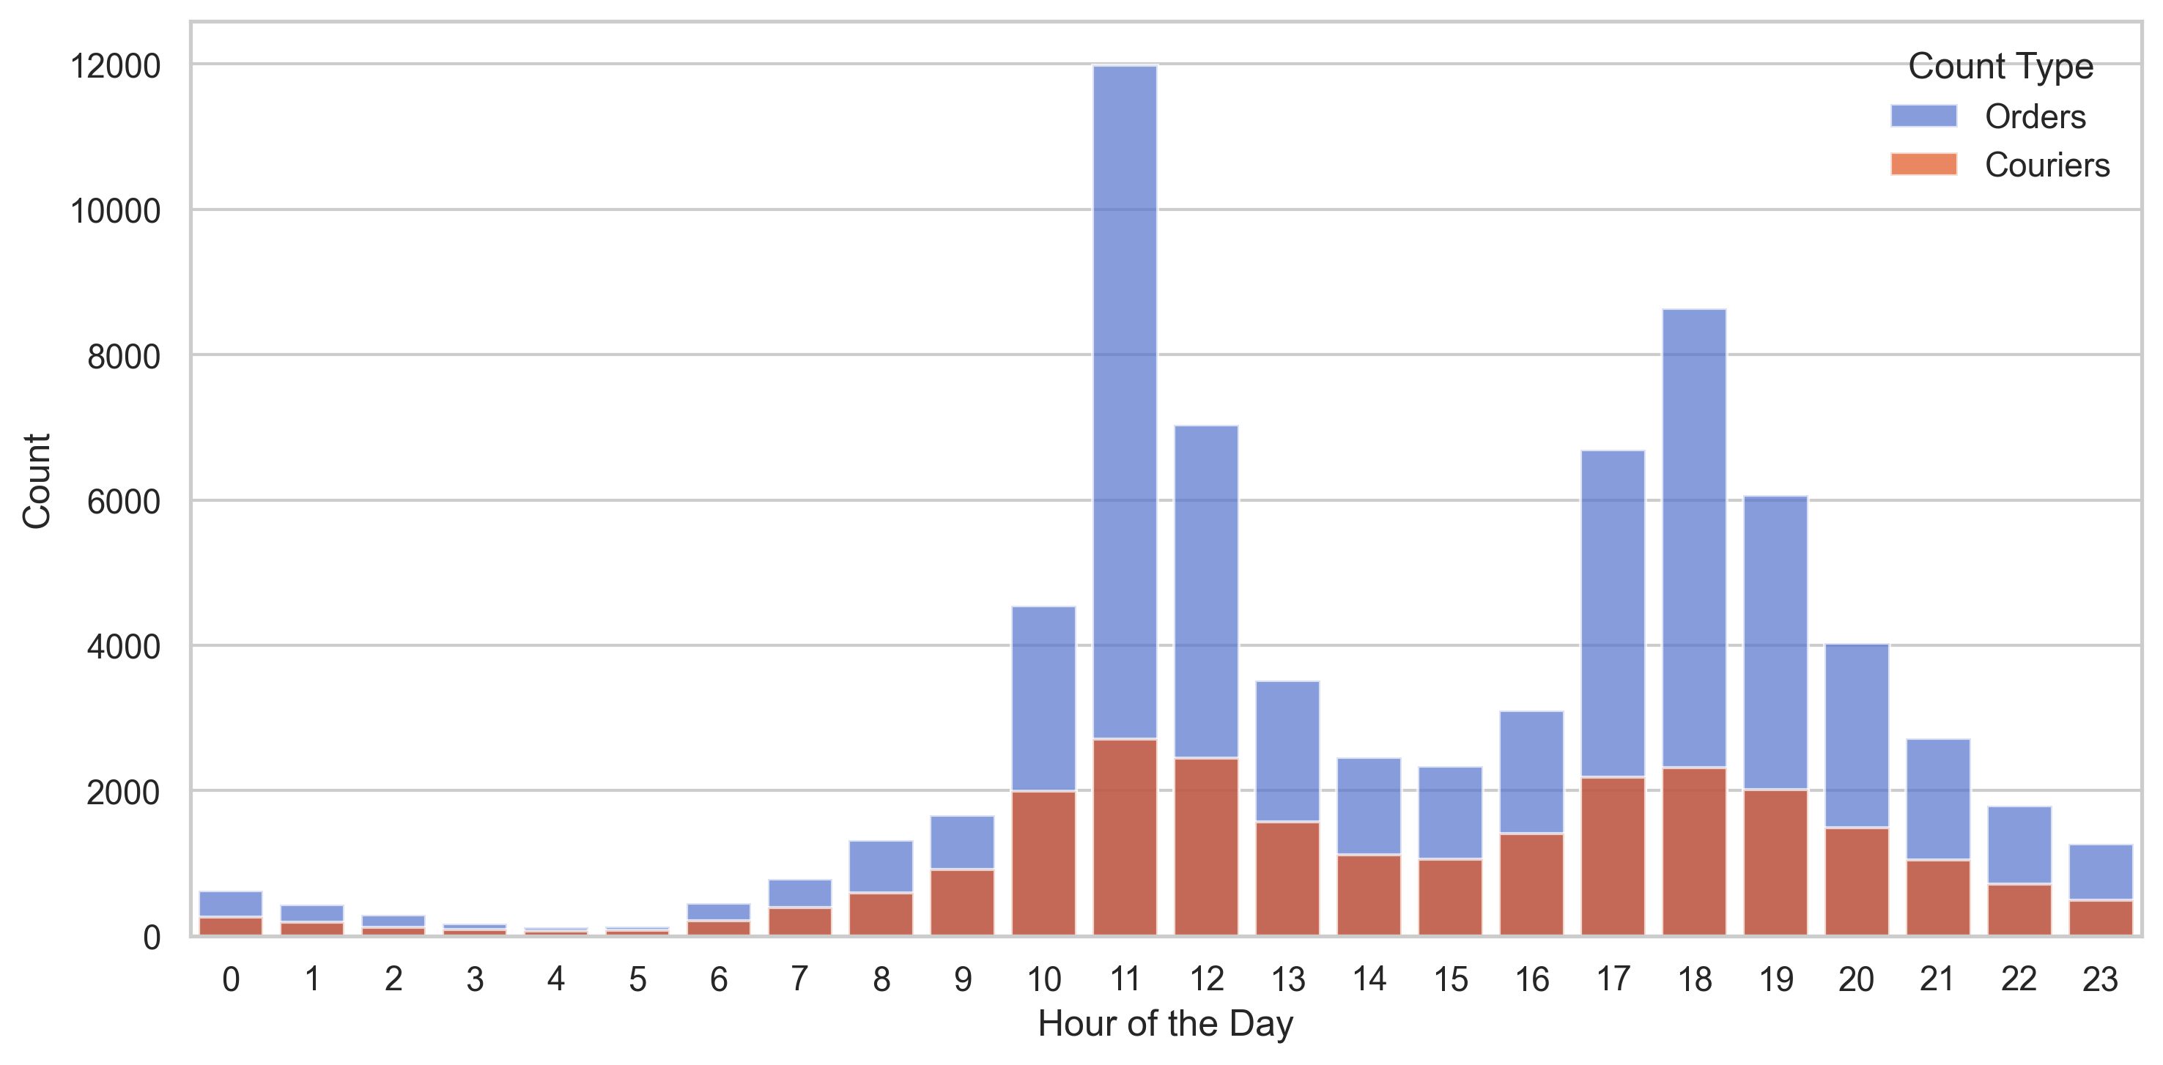
Experiment Setup
Dataset: Meituan operation-level food delivery data (2022-10-17 to 2022-10-24, INFORMS TSL-Meituan 2024 Challenge);
Choose peak hour (11:00 AM - 1:00 PM) orders;
30 seconds for one epoch;
Haversine distance for distance computation.
Courier Type Classification:
Platform-Hired Couriers:
Mandatory assignment acceptance;
Less likely to speeding.
Crowdsourced Couriers:
Order rejection permitted;
Lower penalties for speeding;
Higher penalties for delivery delays.
Notes:
1min

Slide 19
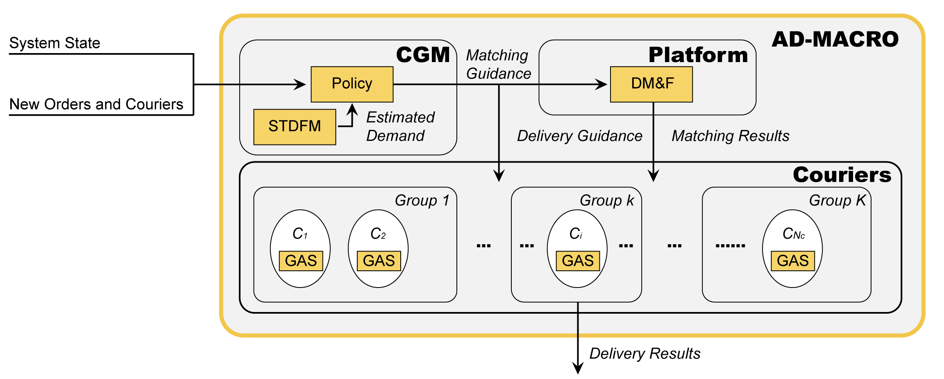
Algorithm Comparison
AD-MACRO
Meituan Benchmark (Actual)
Ignore RL
Ignore DM&F
Existing
Proximity-Based Algorithm (PBA)
Notes:
1min

Slide 20
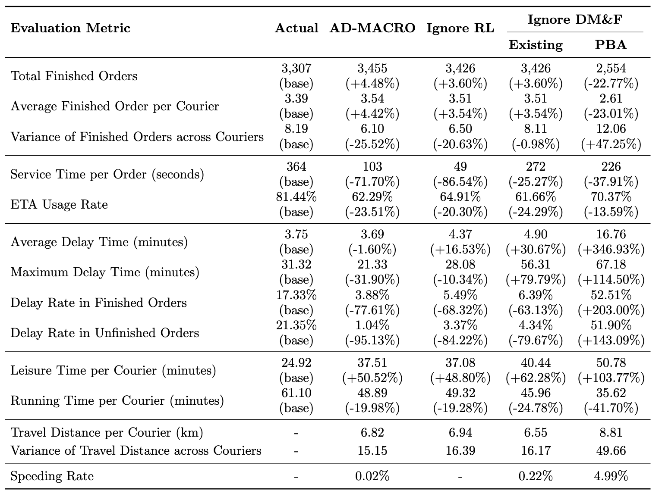
Benchmark
AD-MACRO achieves top performance across all metrics;
Ablation:
Ignore RL (better) : effectiveness of our lower layer;
Existing (better): contributions beyond DM&F;
Ignore RL (better than Ignore DM&F): the critical role of the matching mechanism in overall performance.
Notes:
2min

Slide 21
Detailed Comparison with Actual Dispatching
Order Allocation:
 | Actual | AD-MACRO
Proximity-Short Orders | 2,041 | 1,448
Proximity-Long Orders | 1,800 | 2,393
Service Time per Order:
 | Actual | AD-MACRO
Proximity-Short Orders | 321s | 96s
Proximity-Long Orders | 480s | 104s
Notes:
1min

Slide 22
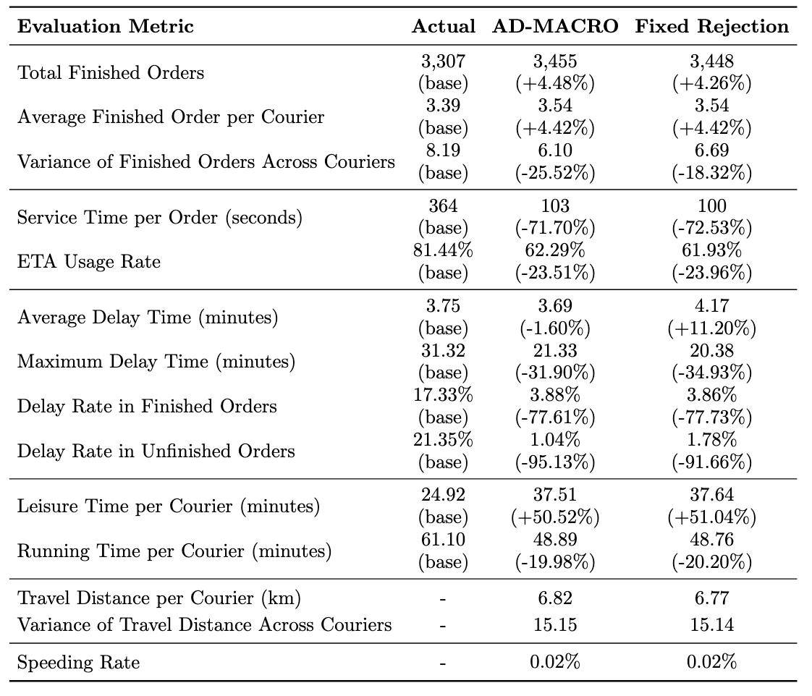
Extension: Courier Reject Behavior
Crowdsourced couriers with a 10% reject rate；
AD-MACRO maintains comparable performance with sustained benefits over the Meituan benchmark.
Modest improvements observed in certain metrics, indicating that incorporating this behavior does not inherently degrade performance.

Slide 23
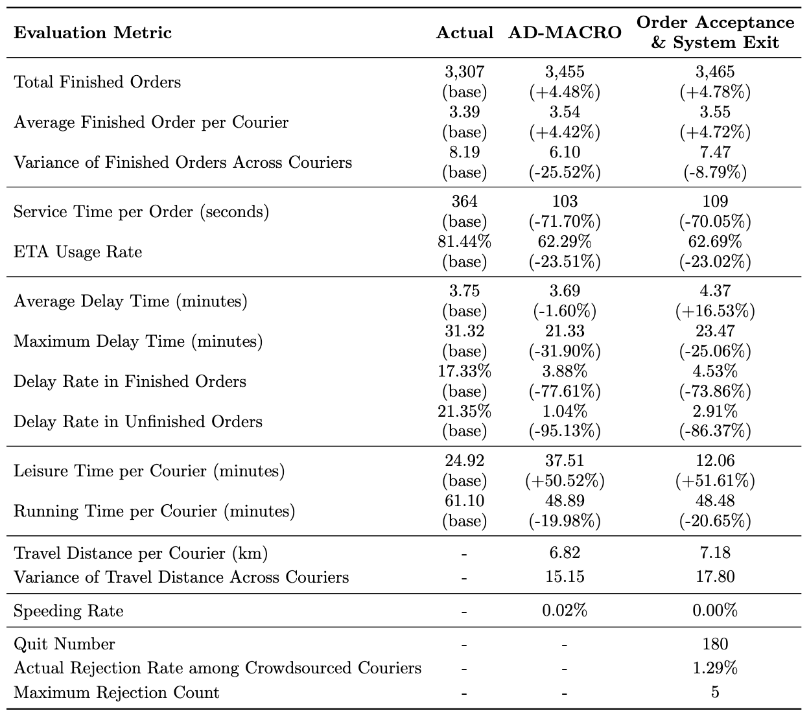
Extension: Courier Reject Behavior
Assumptions:
Crowdsourced couriers may quit if no assignment within 10 minutes;
Rejection behavior relates to the price.
Results:
The rejection rate is 1.29%, compared to 12% in the real-world data;
Maximum number of rejections of one order is only 5;
With a slight decrease in some metrics, AD-MACRO still outperforms.

Slide 24

Extension: Evaluation Across the Whole Area
AD-MACRO maintains superior efficiency.

Slide 25
Conclusion
A Novel Framework for In-Time Delivery: AD-MACRO integrates methods of RL (GAPPO) and OR (DM&F, GAS, STDFM);
Matching Mechanism: The framework considers resource reservation and long-term optimality over mere proximity;
Win-Win-Win Outcomes: Case studies on Meituan dataset demonstrate AD-MACRO's performance benefits all stakeholders, including the platform, couriers, customers and participates in the traffic system.

Slide 26

THANKS!

